Slide 1
AT Command for Socket 1/2
Zach Lin
Connected Home BG
2023/11/06
Jan. 2012

Slide 2
Outline
Roadmap
AT@SOCKDIAL
AT@SOCKCREAT
AT@SOCKCONN
references

Slide 3
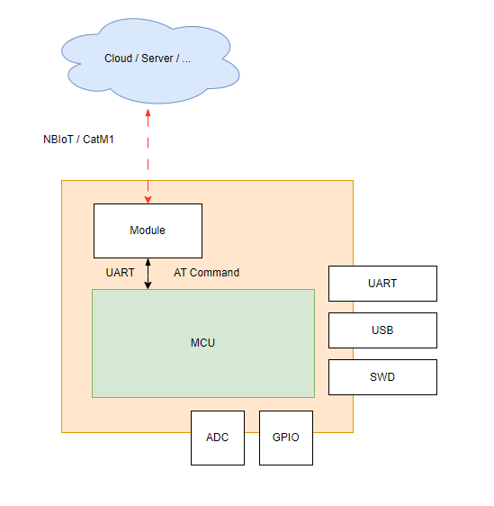
Roadmap
Notes:
Socket command give the external process (MCU)，the ability to connect to internet.
Cuz some MCU (without RTOS lib)，can’t connect to internet by their own.
Usually module use UART as the main interface to exchange data with MCU.

Slide 4
AT@SOCKDIAL
This command servers to dial up the packet switch data service for socket connections
In order to use socket for later communication, we’ve to dial up at first time
Command structure
AT@SOCKDIAL=<action>
AT@SOCKDIAL?
AT@SOCKDIAL=?
Notes:
通過撥號連接到網路。當需要連接到網路時，會通過撥號建立連接，資料通過封包交換的方式在網路中傳輸

Slide 5
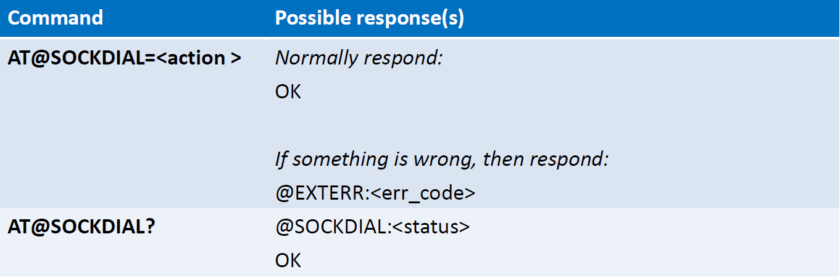
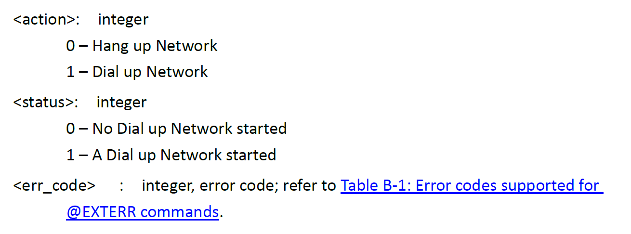
AT@SOCKDIAL
Notes:
Dial up → 撥號連接到網路
Hang up → 結束網路連接

Slide 6
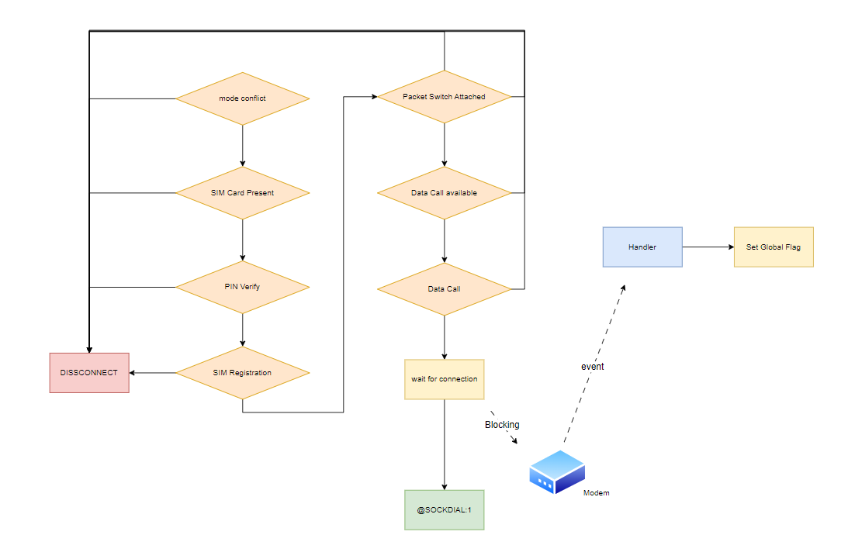
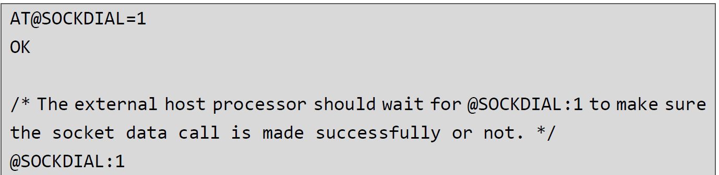
AT@SOCKDIAL
Notes:
Mode: ECM Call, Socket Call
In the implementation of AT@SOCKDIAL, we have to make sure that PS is attached, which means module is already register to Network (IMEI, IMSI).
Then, a Data Call will be launched in order to obtain IP address and activate PDP.
The external host processor should wait for @SOCKDIAL:1 to make sure the socket data call is made successfully or not .

Slide 7
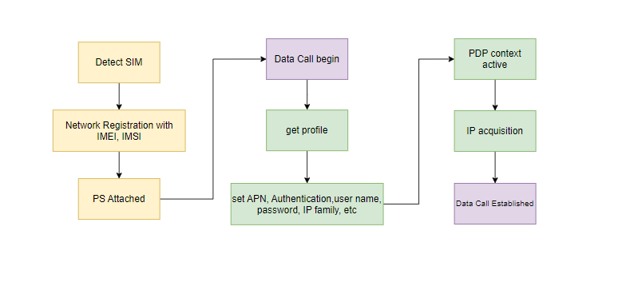
AT@SOCKDIAL
Notes:
Yellow part: prerequisite of Data Call
Green part: the process of Data Call
PDP will be filled in : APN, Authentication (PAP,CHAP), user name, password, IP family
Wait for event → change connection status → blocking

Slide 8
AT@SOCKDIAL – Go Deeper
When will data call be available
PLMN established
Roaming enable
Process of data call
wnc-mal
Authentication
PAP mechanism
CHAP mechanism
PDP activation detail
Notes:
What I can learn form it.

Slide 9
AT@SOCKCREAT
This command servers to create a socket
Socket will return to external host (ex. MCU)
Command structure
AT@SOCKCREAT=<protocol_type>,[ip_version]
AT@SOCKCREAT?
AT@SOCKCREAT=?
Notes:
The command will return a socket number to MCU

Slide 10
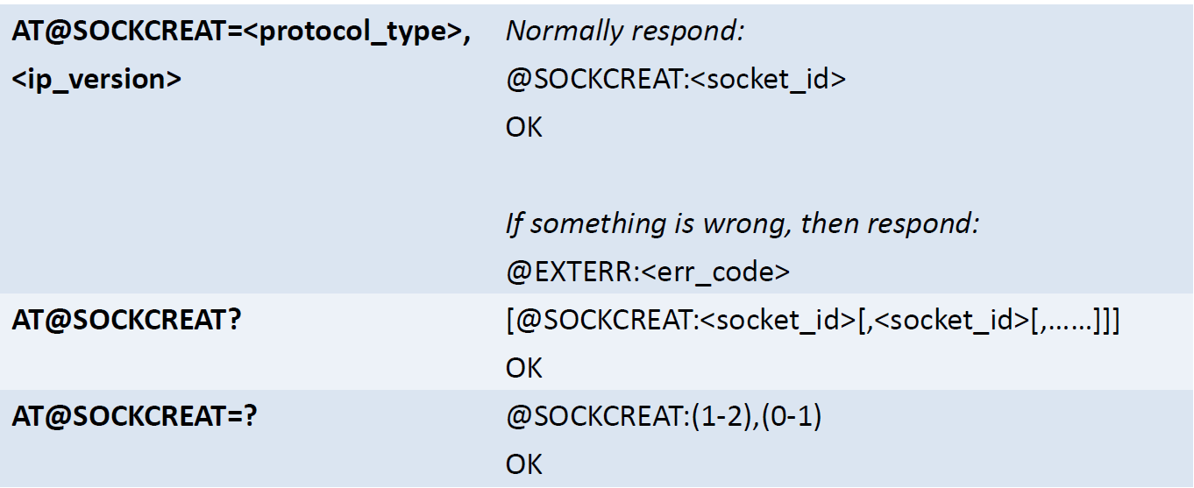
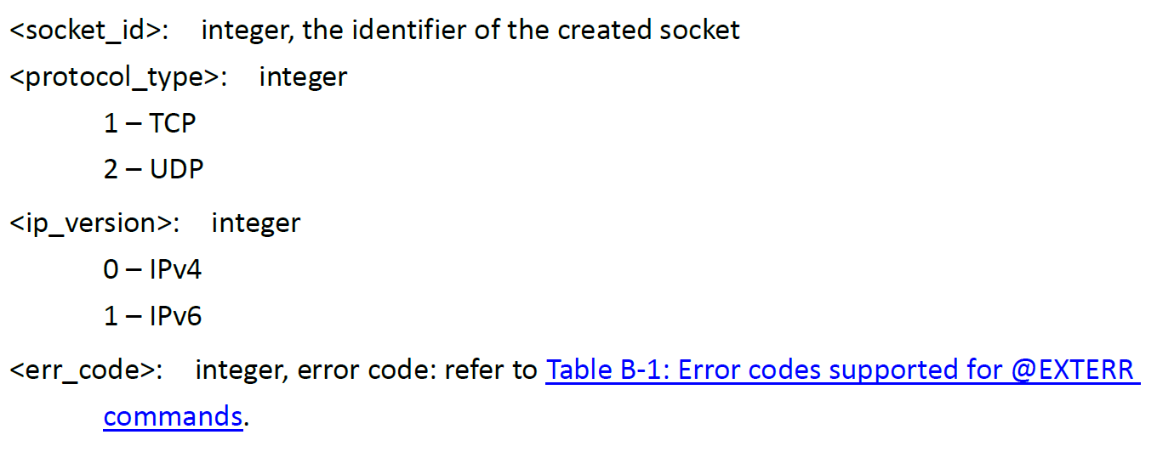
AT@SOCKCREAT
Notes:
Max socket number is 6.
Returning socket number start from 1 not 0.

Slide 11
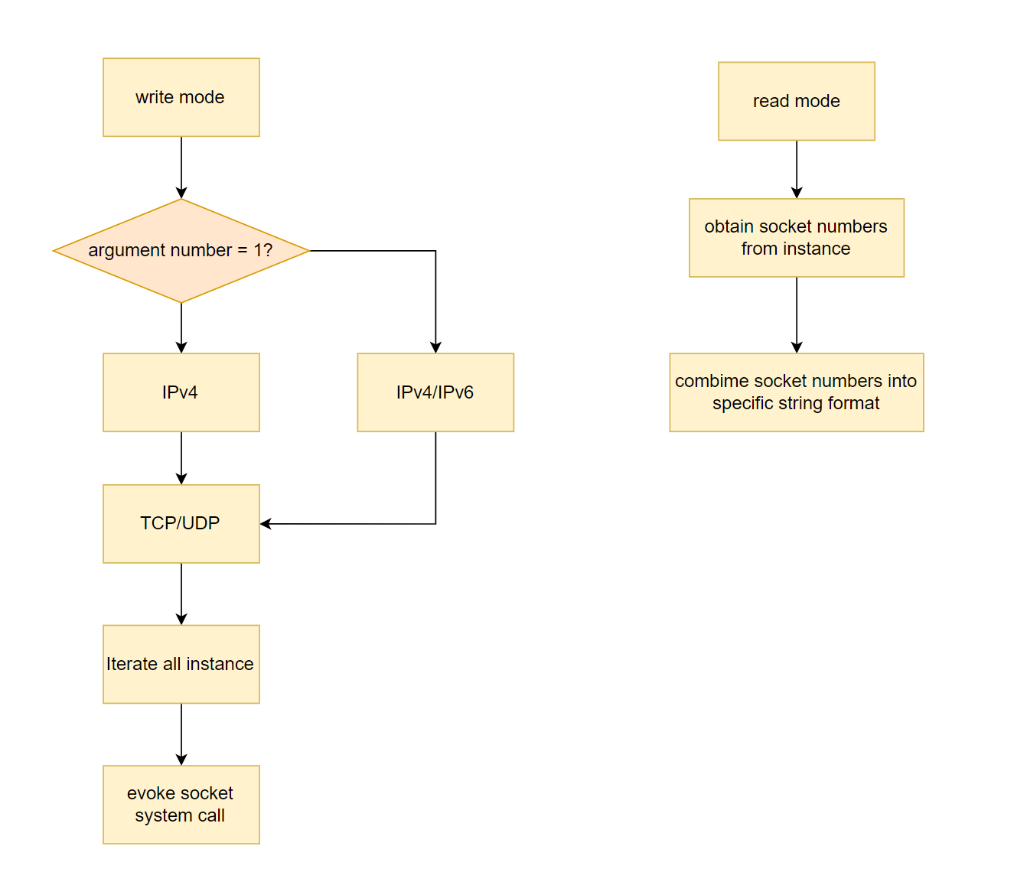
AT@SOCKCREAT
@SOCKCREAT:1,2,3
Notes:
Default IP version is IPv4.
Find a instance that is “SOCKOP_FD_NOT_READY”. (fd == -1)
Use ‘sdata_p = sockop_get_instance_by_id(SOCKOP_ID_COUNT_BASE(i));’ to get socket
sdata_p->fd = socket(AF_INET, SOCK_STREAM, 0);
sdata_p->version = version; // IPv4, IPv6
sdata_p->protocol = protocol; // TCP, UDP

Slide 12
AT@SOCKCONN
This command serves to connect a remote server for the specific TCP socket
*Theoretically, if you create a socket base on UDP, this command is not required
Command structure
AT@SOCKCONN=<socket_id>,<destination_ip_address>,<remote_port>,[connection_timeout]
AT@SOCKCONN?
AT@SOCKCONN=?

Slide 13
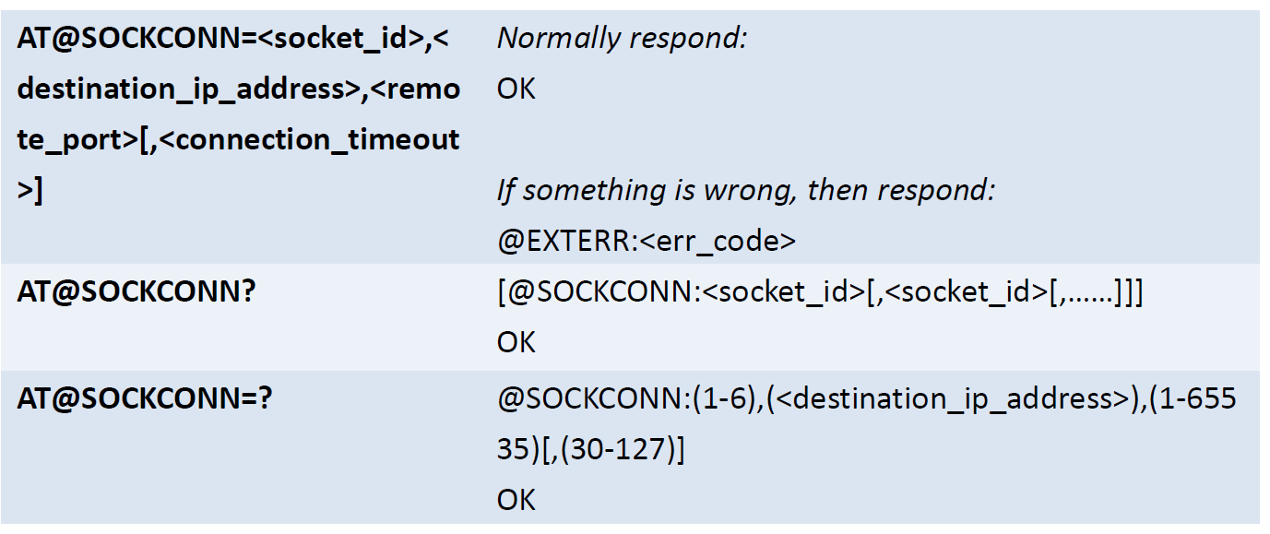
AT@SOCKCONN

Slide 14
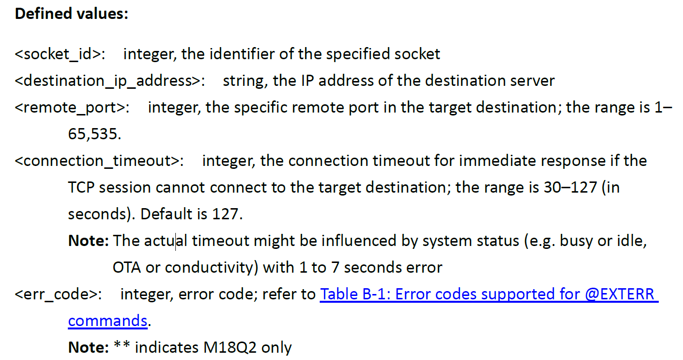
AT@SOCKCONN
Notes:
socket_id range form 1 to 6
destination_ip_address → the ip address of the server → “xxx.xxx.xxx.xxx”
connection_timeout → waiting for TCP session connection
Reset socket timeout after socket connect op

Slide 15
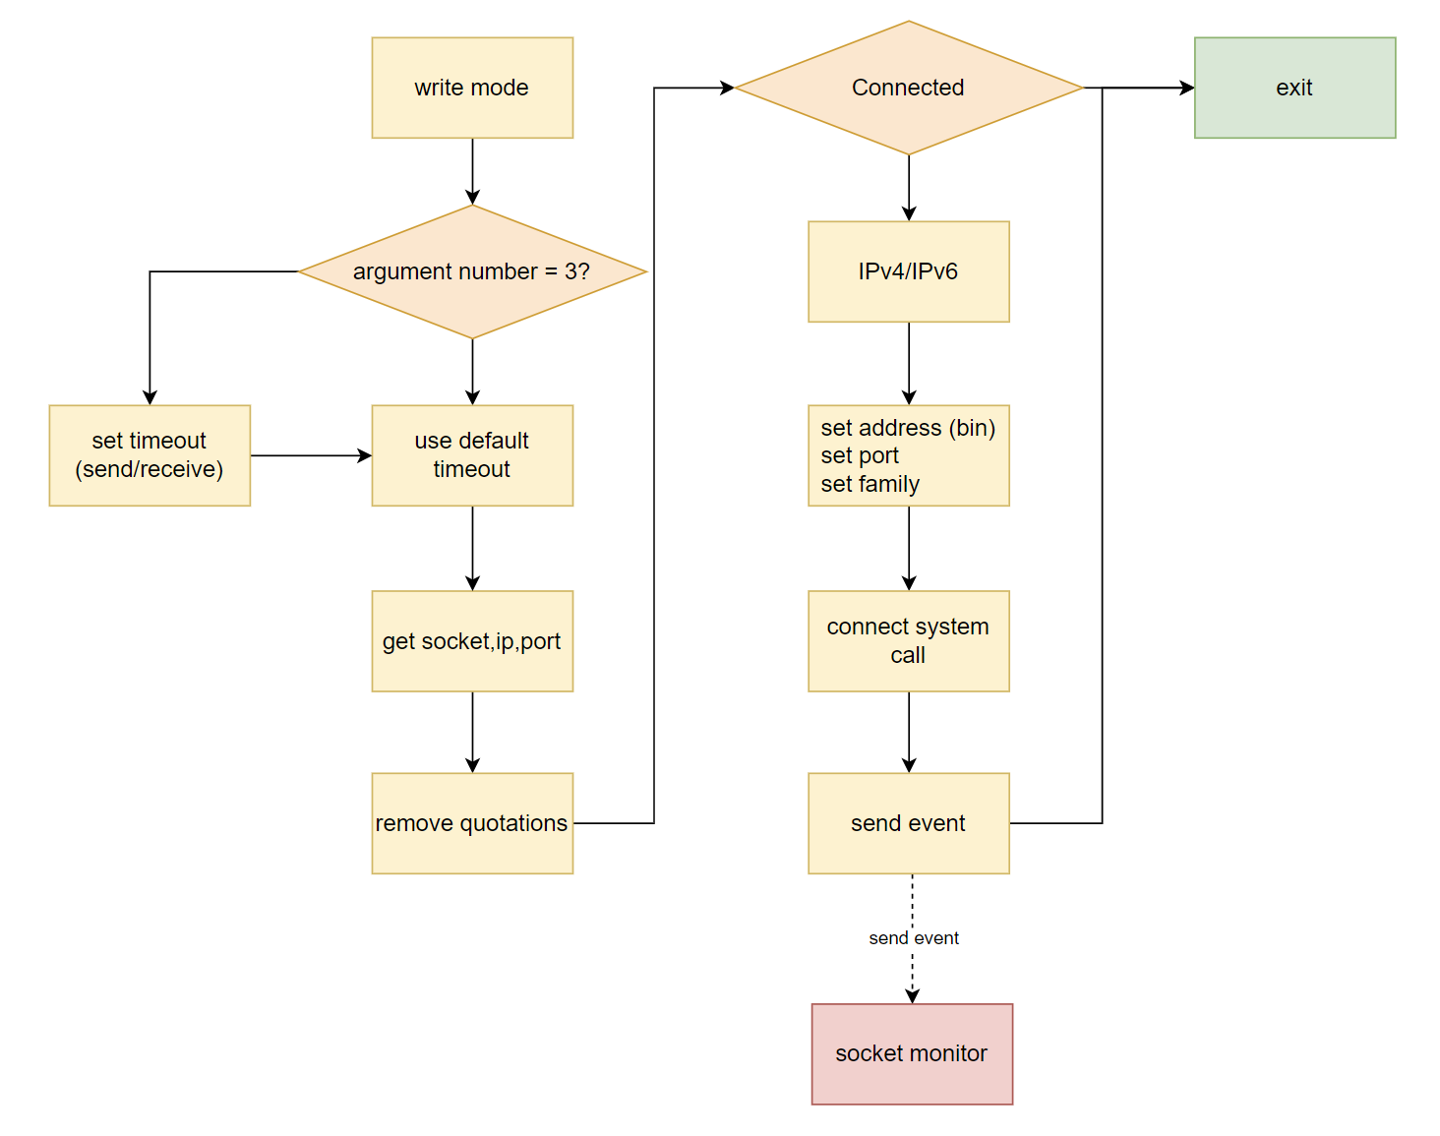
AT@SOCKCONN
AT@SOCKCONN=1,”XXX.XXX.XXX.XXX”,65535,127
Notes:
Timeout should be set for both sending and receiving.
Get socket number, IP address, Port form argv[i]
Remove “”
Set sockaddr_in server_address_ipv4. sin_port to inet_pton(AF_INET, ip_addr, (void *)&server_addr_v4)
connect will block until success or error occur.
“result_fcntl = fcntl(sdata_p->fd ,F_GETFL, 0);
fcntl(sdata_p->fd, F_SETFL, result_fcntl | O_NONBLOCK);
”
Get socket fd status and change it to non-blocking mode

Slide 16
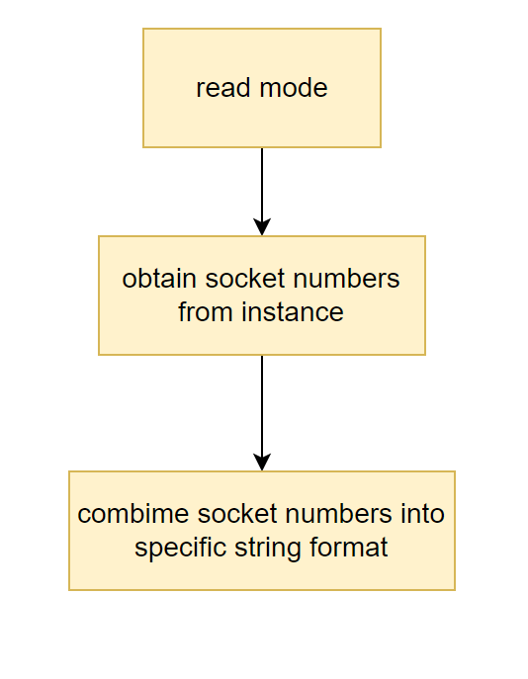
AT@SOCKCONN
@SOCKCONN:1,2,3
Notes:
sdata_p->session_status == SOCKOP_SS_CONNECTED

Slide 17
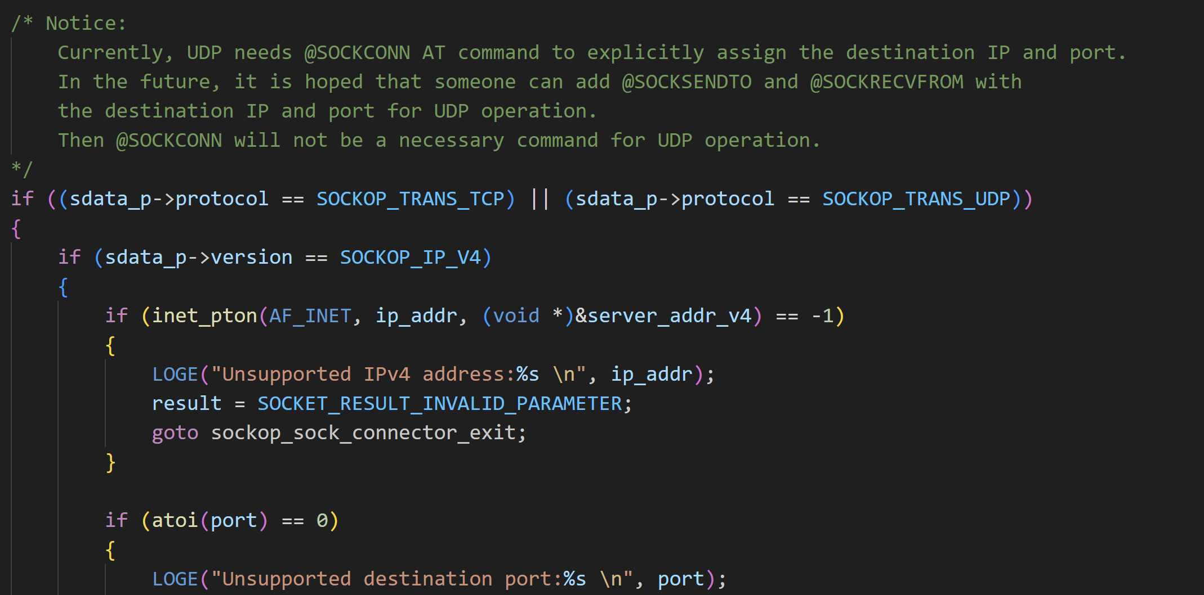
AT@SOCKCONN
Why UDP need connect to send / receive data?
Assign IP, port, famly

Slide 18
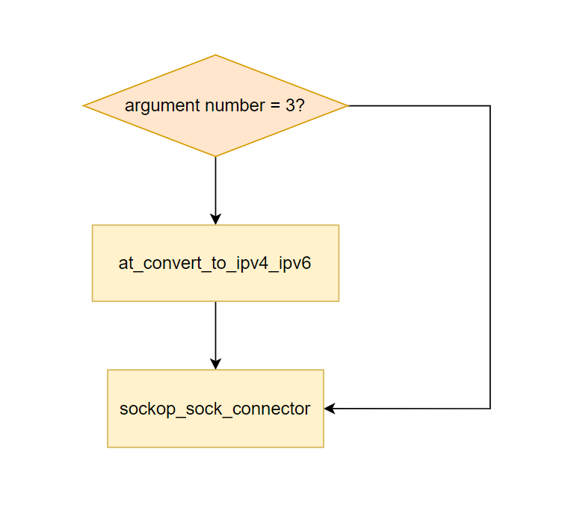
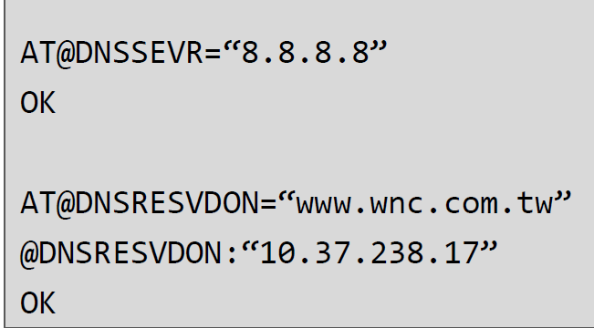
AT@SOCKCONN
at_convert_to_ipv4_ipv6
getaddrinfo
inet_ntop
Why only evoke when args = 3
Support domain name?
AT@DNSRESVDON
Notes:
getaddrinfo() will get a linked list header point to a addrinfo type of node
socket address (bin) → inet_ntop → xxx.xxx.xxx.xxx
IPv4 use malloc and then free, but IPv6 directly use argument directly form input_token

Slide 19
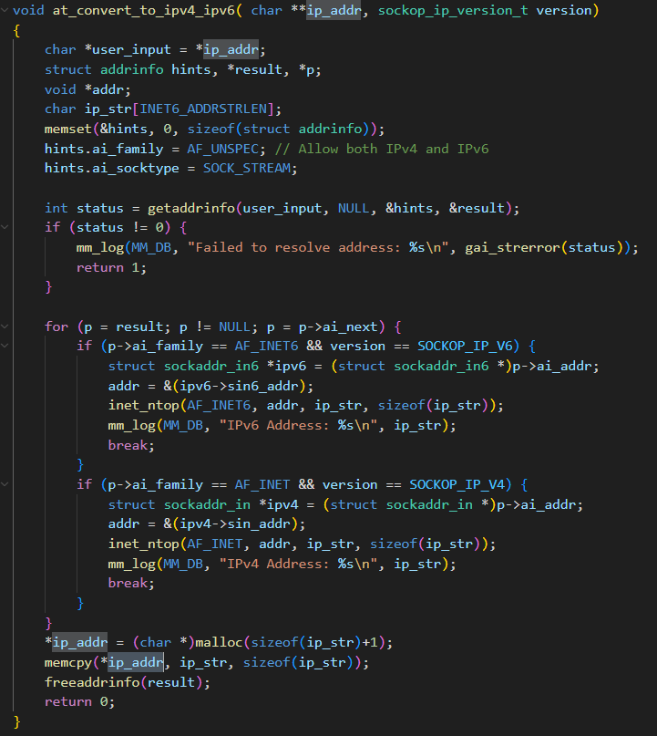
AT@SOCKCONN
at_convert_to_ipv4_ipv6
IPv6 max length: 45 + 1
Inet_ntop will add \0 at the end
malloc issue
allocate 47 bytes, but no \0
no need for 47 bytes
INET6_ADDRSTRLEN

Slide 20
references
WNC AT Commands Guide
mdm9x07

Slide 21
Thank you for your attention

